Slide 1



Y can be a Vowel
Does the Y say the Long E or the Long I sound? Can you put the words in the right list!
fry
tiny
daily
buy
try
my
cry
guy
happy
shy
jelly
really
candy
you
Long ‘e’ sounds
Long ‘i’ sounds
Can you see the odd one out? Write it here if you can _________

Slide 2
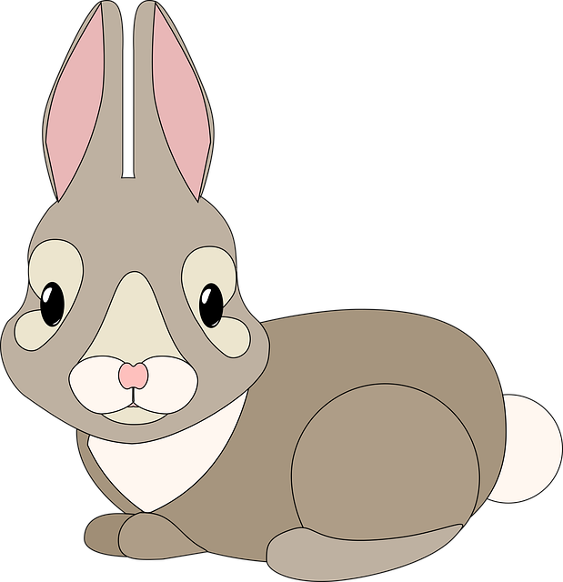
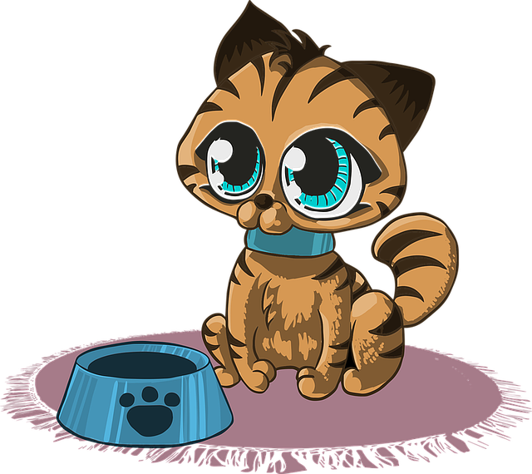
Colour the
Y Sound
Can you read the words with the letter Y, then colour the ones that end with the LONG ‘’e’’ sound red, and colour the ones that end with LONG ‘’i’’ blue!
fry
buy
baby
shy
fly
cry
tiny
you
why
spy
happy
my
shy
silly
sunny
guy
dry
body
easy
bunny
sky
kitty
Can you spot the odd one out, colour it green if you can?

Slide 3
What Sound does
Y Make?
Can you write what sound the letter Y makes in these words! It can be Long ‘’e’’, Long ‘í’’ or it can even say ‘’y’’
yellow
you
belly
shy
kitty
yes
fly
young
happy
crazy
dry
silly

