Slide 1


CHEESE
CHICKEN

Slide 2


EGGS
ICE CREAM

Slide 3


JUICE
CANDIES

Slide 4


MEAT
MILK

Slide 5
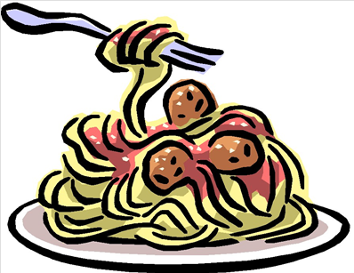
FISH
SPAGHETTI

Slide 6


RICE
BREAD

Slide 7


JAM
HONEY

Slide 8


SOUP
WATER

Slide 9


VEGETABLES
HAMBURGER

Slide 10


MUSHROOM
PIZZA

